Slide 1


Spatial Computing: From Manifold Geometry to Networking and Biology
Jacob Beal
February, 2012
Work partially sponsored by DARPA; the views and conclusions contained in this document are those of the authors and not DARPA or the U.S. Government.

Slide 2
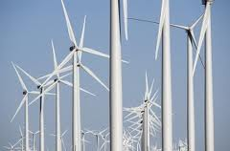
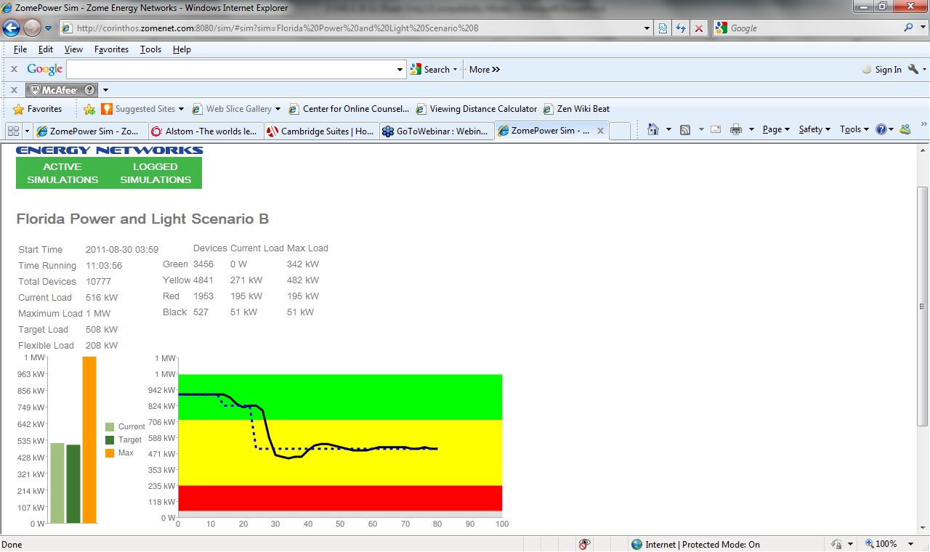
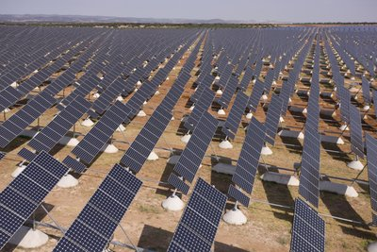
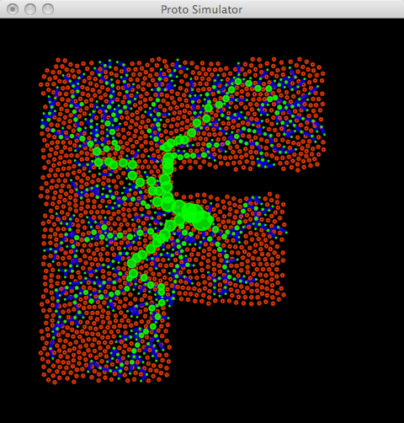
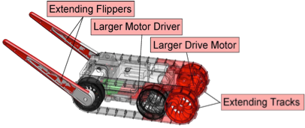
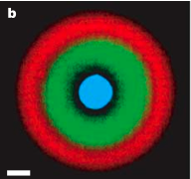
How can millions of appliances coordinate to change how we use energy?
How can the parts of a design work together to adapt it to new uses?
How do you
program space?
Distributed Power
Demand Response
Morphogenetic
Engineering
device
neighborhood
Spatial
Computing
Synthetic
Biology
IPTG
F
GFP
H
How do you program the behavior of 10¹² cells?
LacI
TetR
aTc
H
F

Slide 3
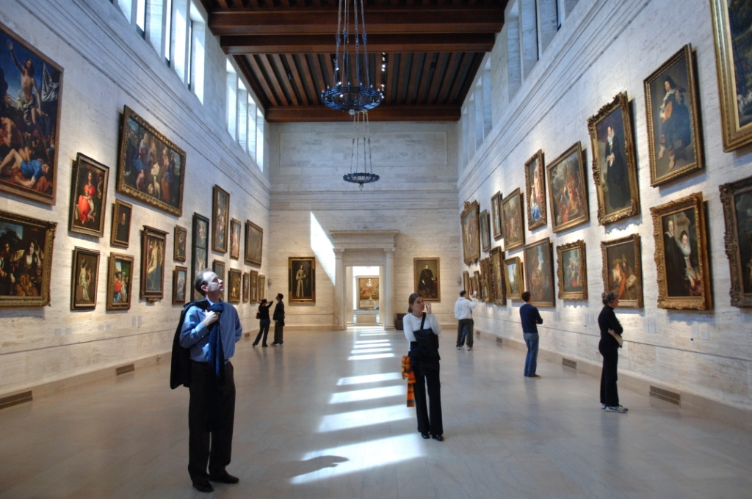
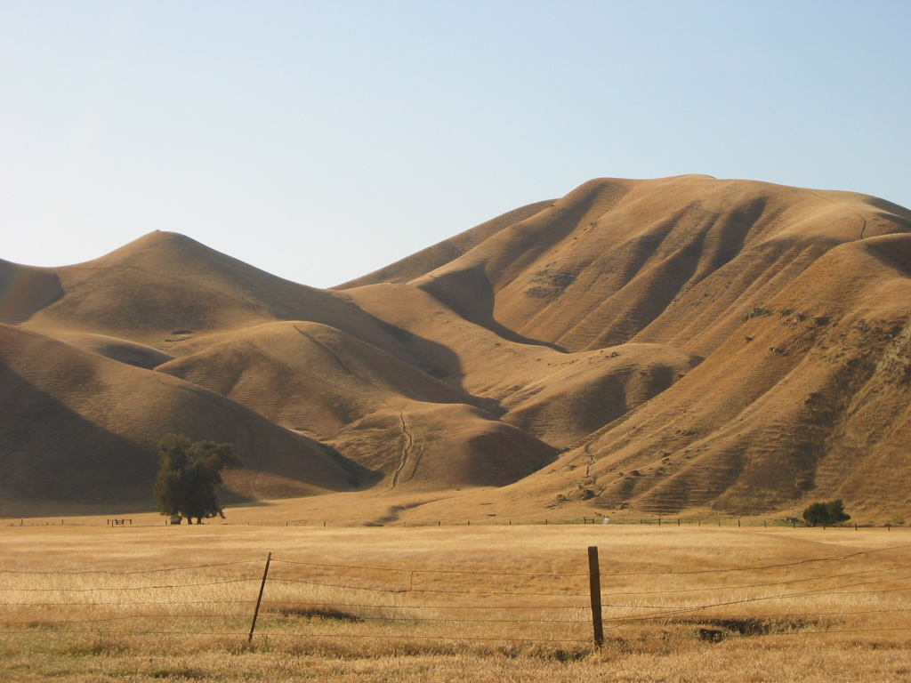
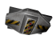
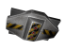
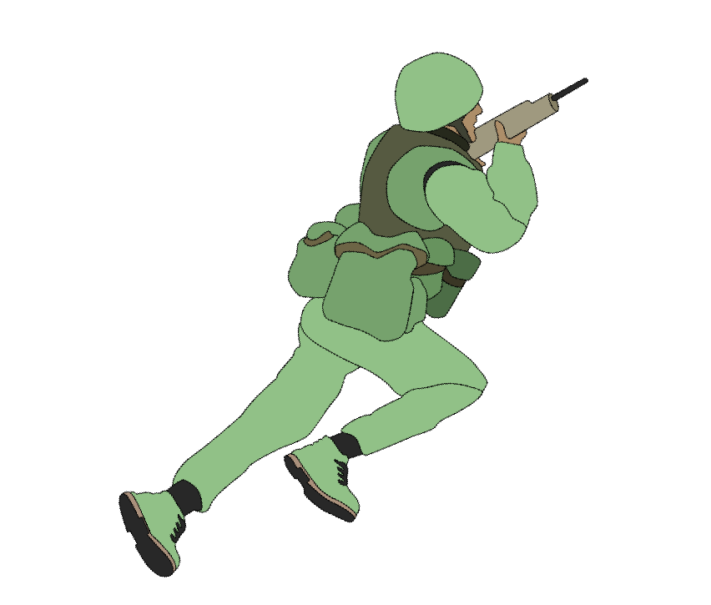
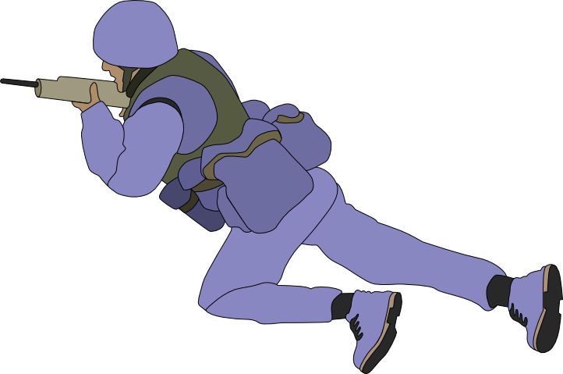
When the world is geometric…
Morphogenetic Engineering
Pervasive Computing
Sensor Networks
… take advantage of it!

Slide 4
How do you
program space?
Distributed Power
Demand Response
Morphogenetic
Engineering
device
neighborhood
Spatial
Computing
Synthetic
Biology
IPTG
F
GFP
H
LacI
TetR
aTc
H
F

Slide 5
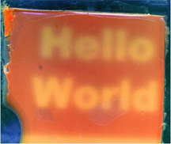
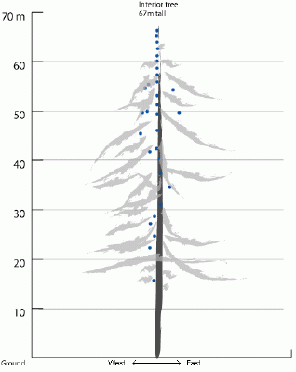
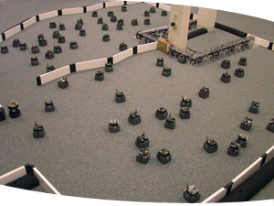
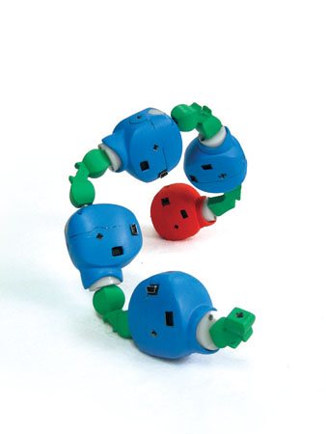
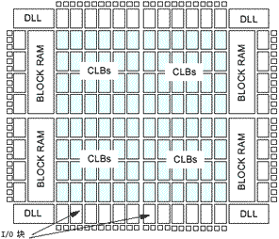
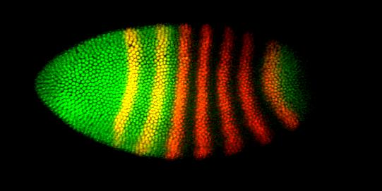
Spatial Computers
Biological Computing
Sensor Networks
Robot Swarms
Modular Robotics
Cells during Morphogenesis
Reconfigurable Computing
Notes:
From my perspective, I'm more interested in the problems of spatial computing, and biological computing is one particular application domain.
A spatial computer is any collection of devices distributed to fill space, where the difficulty of moving information between two devices is strongly dependent on the distance between them.

Slide 6
More formally...
A spatial computer is a collection of computational devices distributed through a physical space in which:
the difficulty of moving information between any two devices is strongly dependent on the distance between them, and
the “functional goals” of the system are generally defined in terms of the system's spatial structure

Slide 7
Space/Network Duality
device
neighborhood
Notes:
Note that there is a duality between the manifold and the network: either we want a particular manifold, and we look for a network that approximates it well, or we have a network and we look for a manifold that is approximated well by it.

Slide 8
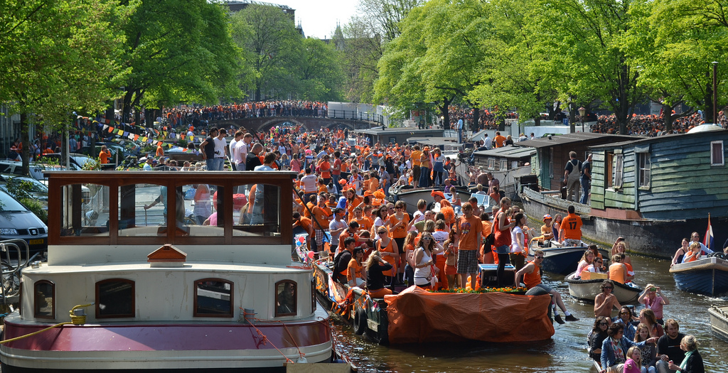
Example: Mesh-Network Cell Phones

Slide 9

Example: Tracking in Sensor Networks
Intruder
Guard

Slide 10
Example: Morphogenesis

Slide 11
How can we program these?
Desiderata for approaches:
Simple, easy to understand code
Robust to errors, adapt to changing environment
Scalable to potentially vast numbers of devices
Take advantage of spatial nature of problems

Slide 12
Example: Mesh-Network Cell Phones

Slide 13
Geometric Program: Channel
Source
Desti-
nation
(cf. Butera)

Slide 14
Computing with fields
source
destination
width
distance-to
distance-to
distance
10
37
+
dilate
<=
Notes:
Functional computation on time-dependent fields

Slide 15
Amorphous Medium
device
neighborhood
Continuous space & time
Infinite number of devices
See neighbors' past state
Approximate with:
Discrete network of devices
Signals transmit state
Notes:
Note that there is a duality between the manifold and the network: either we want a particular manifold, and we look for a network that approximates it well, or we have a network and we look for a manifold that is approximated well by it.
This is the slide where I should show the simulator running “channel”
./proto -n 1000 -r 10 -rad 1 -l "(all (swim (if (sense 1) (dither) (tup 0 0))) (green (channel (sense 1) (sense 2) 10)))" -s 0.1 -m -S 1

Slide 16
Proto
(def gradient (src) ...)
(def distance (src dst) ...)
(def dilate (src n)
(<= (gradient src) n))
(def channel (src dst width)
(let* ((d (distance src dst))
(trail (<= (+ (gradient src)
(gradient dst))
d)))
(dilate trail width)))
evaluation
global to local
compilation
Global Local Discrete
platform
specificity &
optimization
device
neighborhood
discrete
approximation
Device
Kernel
[Beal & Bachrach, '06]

Slide 17
Proto's Families of Primitives
Pointwise
Restriction
+
restrict
Feedback
Neighborhood
41
7
delay
+
nbr
any-hood
48

Slide 18
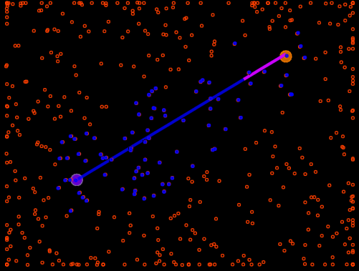
In simulation...

Slide 19
Weaknesses
Programmers can break the abstraction
Functional programming scares people
No dynamic allocation of processes
No formal proofs available for quality of approximation in a composed program
By design
Upgrades
Coming
Soon!
Active
research
area

Slide 20
How can millions of appliances coordinate to change how we use energy?
Distributed Power
Demand Response
Morphogenetic
Engineering
device
neighborhood
Spatial
Computing
Synthetic
Biology
IPTG
F
GFP
H
LacI
TetR
aTc
H
F

Slide 21
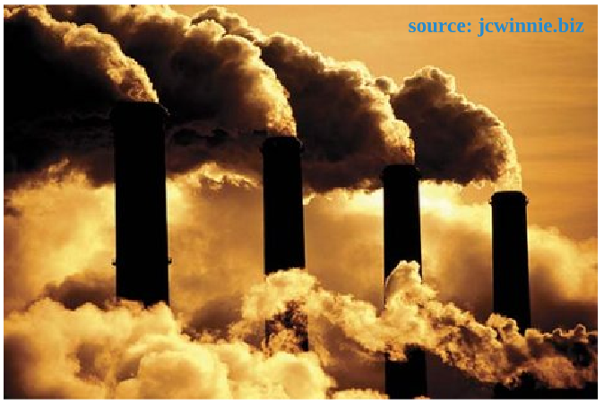
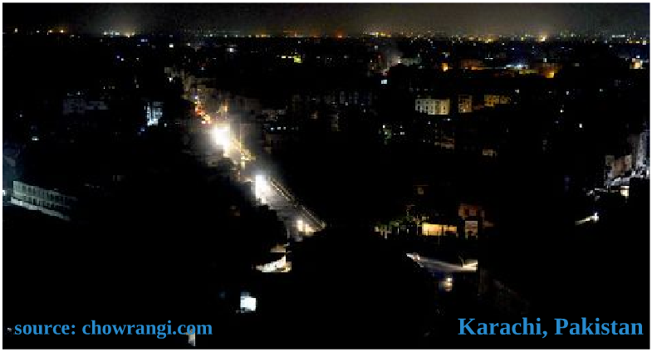
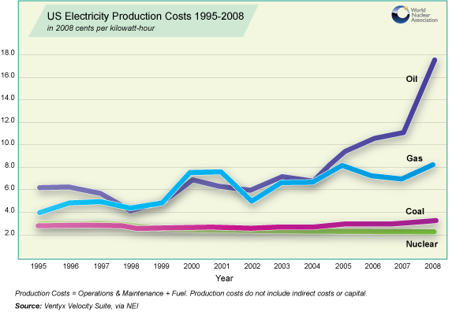
Distributed Power Demand Response
Renewables Integration
Pollution Reduction
Why is DR important?
Peak Power
Costs
Blackout Prevention

Slide 22
Inefficiency of Demand vs. Intention
Demand/supply mismatch is extremely costly
$ billions to utilities, local governments
Consumers dramatically reduce demand when:
… aware of actual appliance energy use
… informed about neighbors' energy use
… aware of stress on power grid
Coordination opportunity: peak-shaving & demand management by automating volunteerism

Slide 23
Key Challenges
Scalability:
Safe, reliable coordinated response from millions of devices in <5 minutes
Consumer interface:
High benefit, low “annoyance factor”
Eliciting useful information
Privacy concerns
Deployability:
Technology alignment with market structure
Low cost devices
Market fragmentation across grid & in home

Slide 24
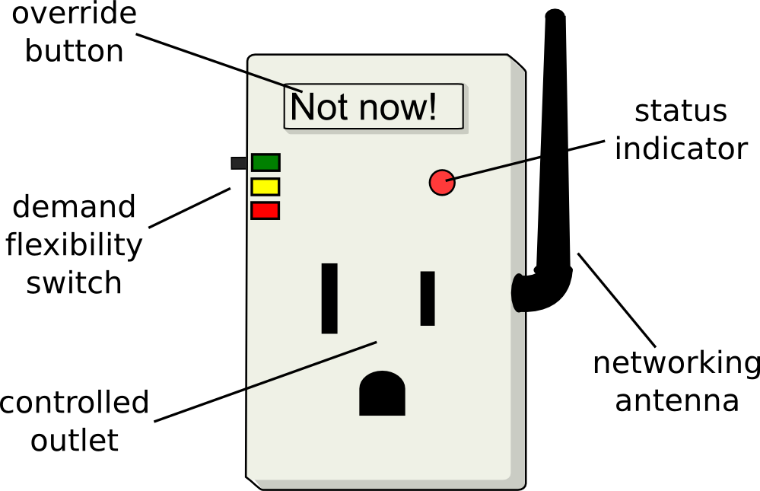
Capturing User Requirements
Anytime Flexible
Peak Power
Emergencies Only
Uncontrolled
Qualitative
Energy Flexibility
Smart plugs, new appliances,
home automation, …

Slide 25

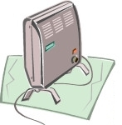
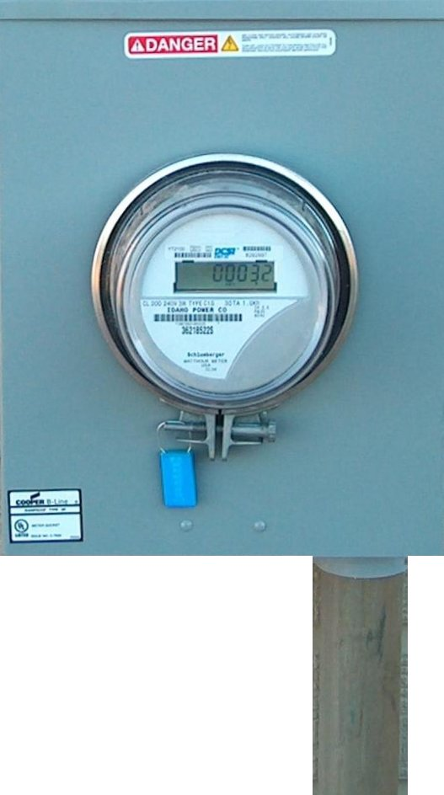
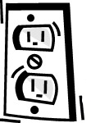


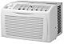

Distributed Creation of Aggregate Model
30
30
800
950
0
224
40
607
382
150
40
183
40
500
200
40
500
75
75
200

Slide 26
Model Coordinates Local Control Actions
0
X
800
224
607
382
150
40
85.2%
183
14.8%
500
Target: 382 MW
Current: 493 MW
(reduce 22.5%)
0
X
X
75
0

Slide 27
ColorPower Algorithm
Challenge: fast, private, robust, non-intrusive
Approach: randomized distributed control
Aggregate flexibilility information to shared model
Disseminate control signals via gossip
Local decision; coin-flip for fractional color
Weight for availability, overdamped control
Control problem: long timeouts on state changes
[Ranade & Beal, IEEE SASO 2010]

Slide 28
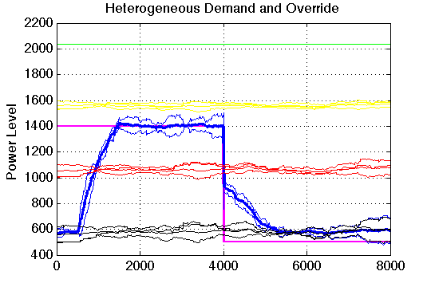
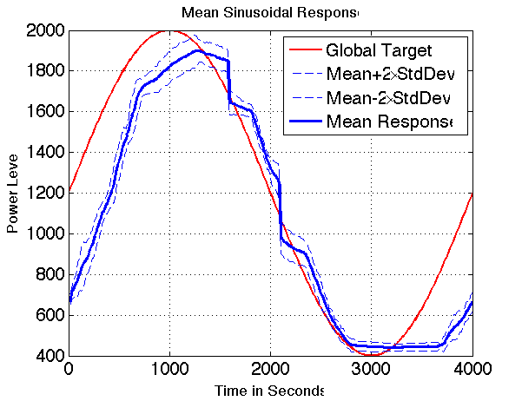
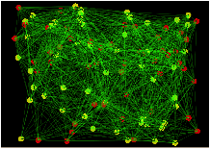
ColorPower Initial Algorithm
Simulation on 100 device network using PID local controller
[Ranade & Beal, IEEE SASO 2010]

Slide 29
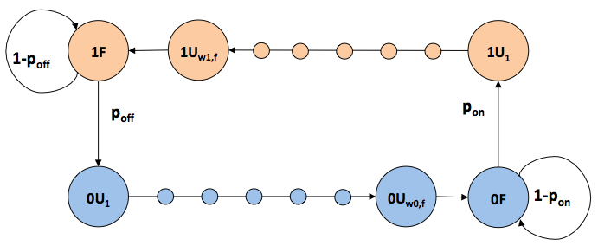
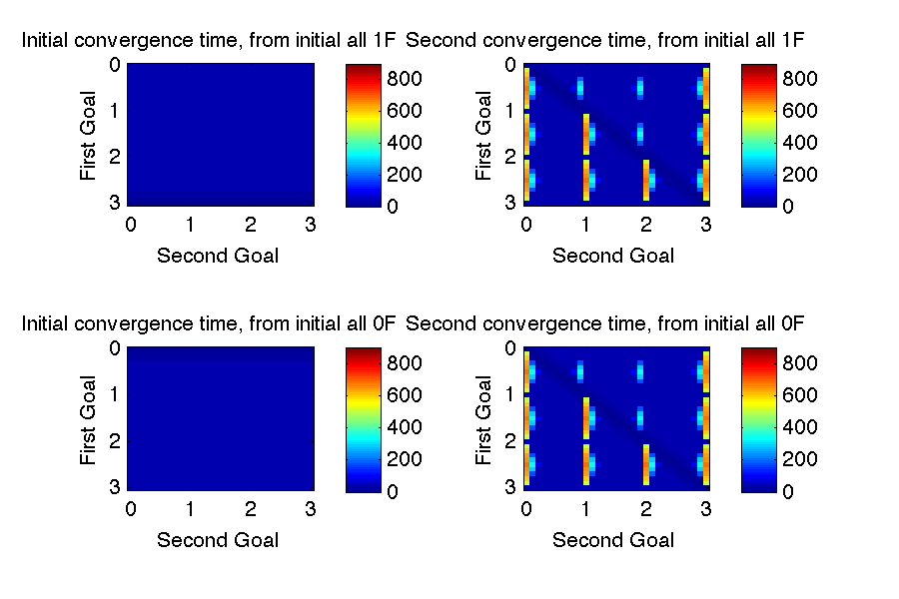
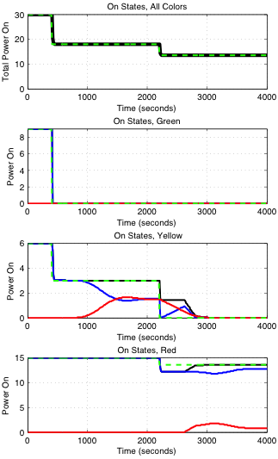
Improved constraint-based controller
Per-Color Markov Model
Wait_{on}
Wait_{off}
Based on a Markov model of state flux…
… devices use constraint-based controls …
… allowing <1 minute aggregate convergence time.

Slide 30

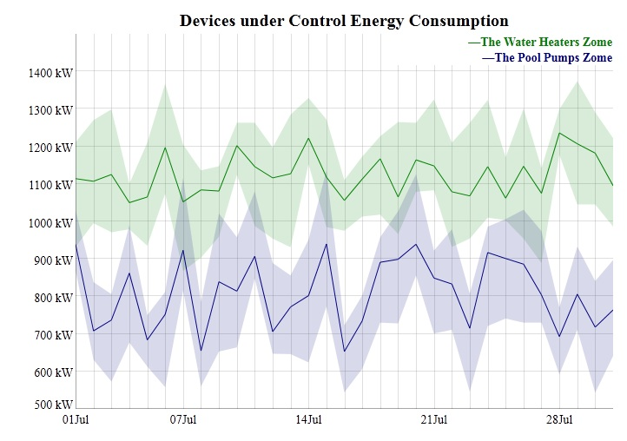

Bringing it to the real world…
Founded 2010 with team of serial entrepreneurs, well-funded, offices in San Francisco and Cambridge, first products in launch process…

Slide 31
Distributed Power
Demand Response
Morphogenetic
Engineering
device
neighborhood
Spatial
Computing
Synthetic
Biology
IPTG
F
GFP
H
How do you program the behavior of 10¹² cells?
LacI
TetR
aTc
H
F

Slide 32
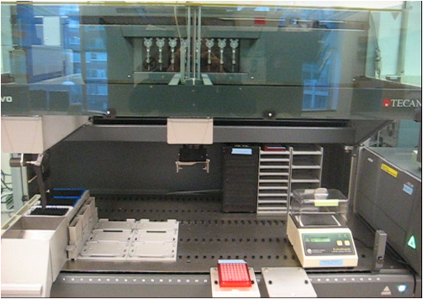

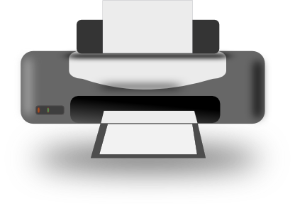
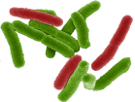

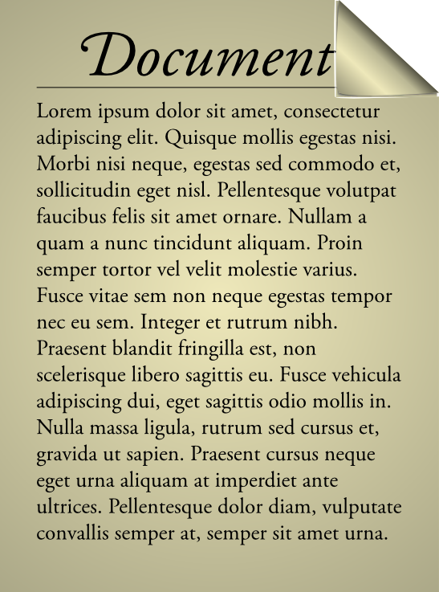
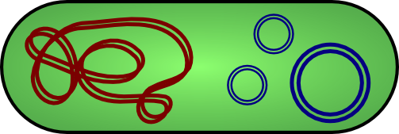
Vision: WYSIWYG Synthetic Biology
Bioengineering should be like document preparation:

Slide 33
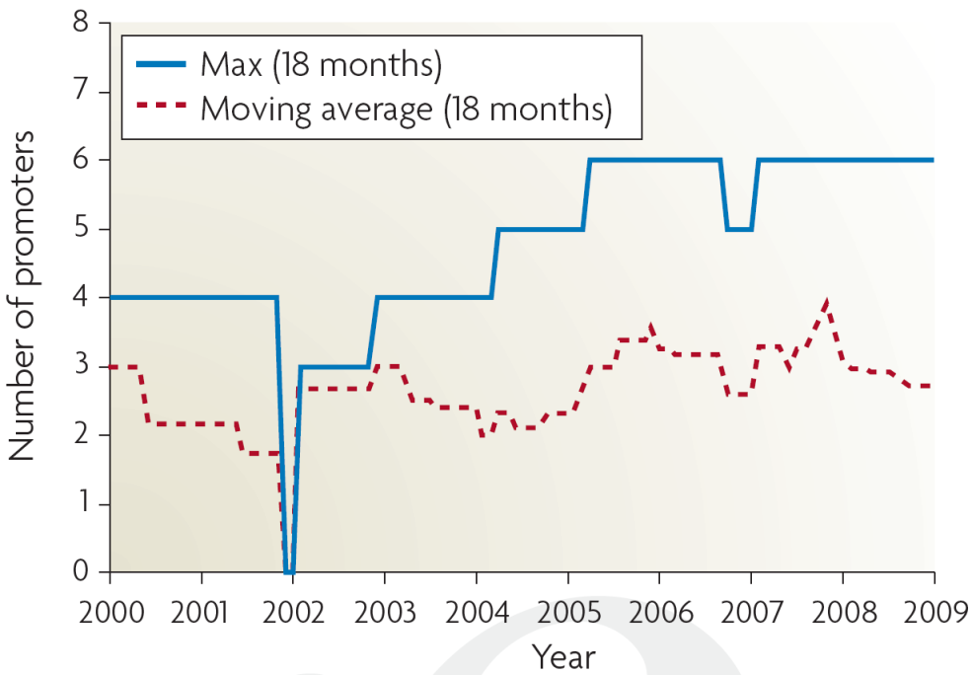
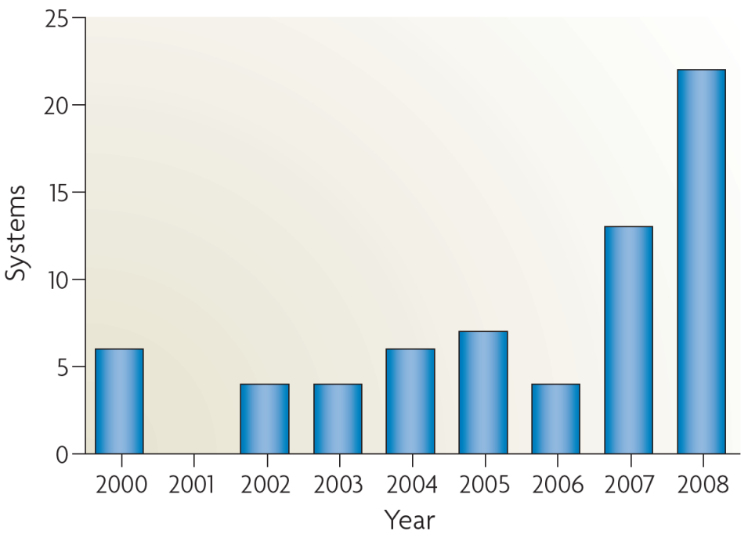
Why is this important?
Breaking the complexity barrier:
Multiplication of research impact
Reduction of barriers to entry
?
DNA synthesis
Circuit size
[Purnick & Weiss, ‘09]
*Sampling of systems in publications with experimental circuits

Slide 34
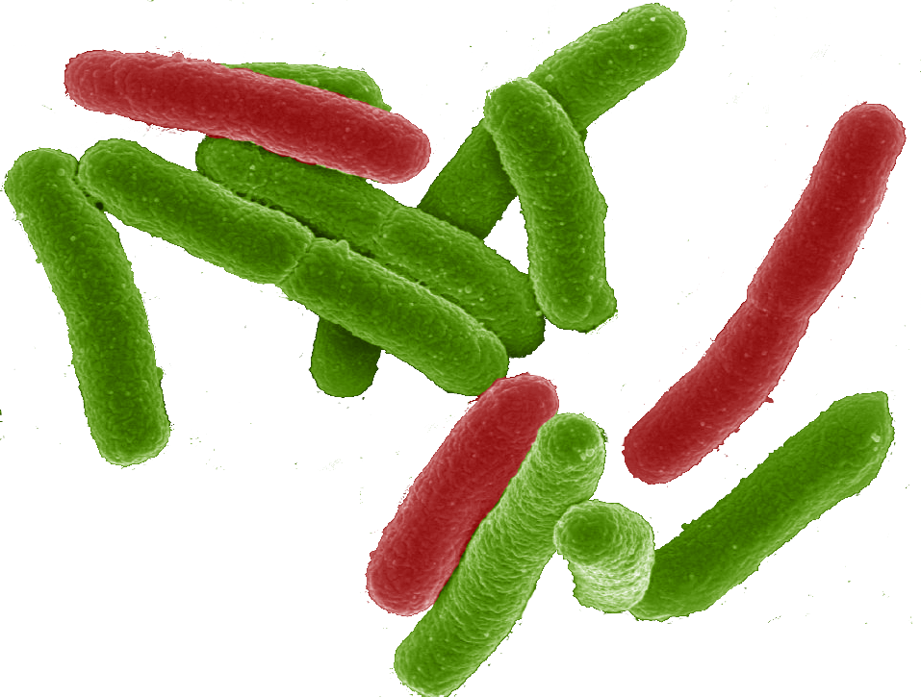
Why a tool-chain?
Organism Level Description
This gap is too big to cross with a single method!
Cells

Slide 35
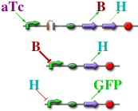
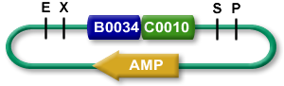

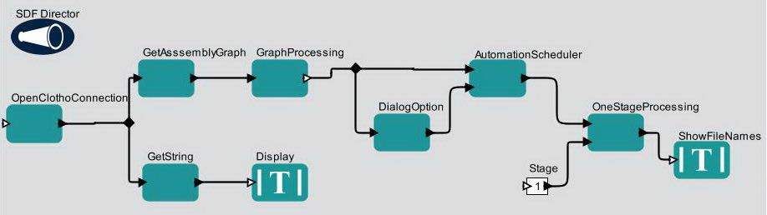

The TASBE architecture:
Organism Level Description
High level simulator
High Level Description
If detect explosives:
emit signal
If signal > threshold:
glow red
Coarse chemical simulator
Abstract Genetic Regulatory Network
Detailed chemical simulator
DNA Parts Sequence
Modular architecture also open for flexible choice of organisms, protocols, methods, …
Collaborators:
Assembly Instructions
Ron
Weiss
Testing
Douglas Densmore
Cells

Slide 36
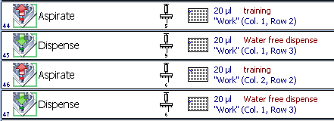
A Tool-Chain Example
(yellow (not (cyan (Dox))))
Dox
cyan
not
yellow
Dox
rtTA
CFP
B
EYFP
pHef1a
rtTA
pTre
CFP
pTre
LacI
mirff4
pHef1a-LacO1Oid
EYFP
4xff4

Slide 37
Today’s focus: BioCompiler
Organism Level Description
High level simulator
High Level Description
Compilation &
Optimization
If detect explosives:
emit signal
If signal > threshold:
glow red
Coarse chemical simulator
Abstract Genetic Regulatory Network
Detailed chemical simulator
DNA Parts Sequence
Assembly Instructions
Testing
Cells

Slide 38
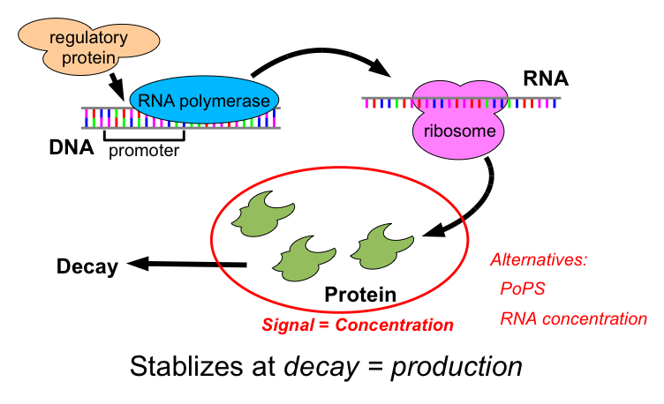
Transcriptional Logic

Slide 39
Motif-Based Compilation
High-level primitives map to GRN design motifs
e.g. logical operators:
(primitive not (boolean) boolean
:grn-motif ((P high R- arg0 value T)))
arg0
value

Slide 40
Motif-Based Compilation
High-level primitives map to GRN design motifs
e.g. logical operators, actuators:
(primitive green (boolean) boolean :side-effect
:type-constraints ((= value arg0))
:grn-motif ((P R+ arg0 GFP|arg0 value T)))
arg0
GFP
value

Slide 41
Motif-Based Compilation
High-level primitives map to GRN design motifs
e.g. logical operators, actuators, sensors:
(primitive IPTG () boolean
:grn-motif ((P high LacI|boolean T)
(RXN (IPTG|boolean) represses LacI)
(P high R- LacI value T)))
IPTG
LacI
value

Slide 42
Motif-Based Compilation
Functional program gives dataflow computation:
(green (not (IPTG)))
IPTG
not
green

Slide 43
Motif-Based Compilation
Operators translated to motifs:
IPTG
not
green
IPTG
A
B
LacI
outputs
arg0
outputs
arg0
GFP
outputs
IPTG
LacI
A
B
GFP

Slide 44
Optimization
IPTG
LacI
A
B
GFP
Copy Propagation
IPTG
LacI
A
B
GFP
Dead Code Elimination
IPTG
LacI
A
GFP
Dead Code Elimination
IPTG
LacI
A
GFP

Slide 45
Complex System: Feedback Latch
(def sr-latch (s r)
(letfed+ ((o boolean (not (or r o-bar)))
(o-bar boolean (not (or s o))))
o))
(green (sr-latch (aTc) (IPTG)))

Slide 46
Complex System: Feedback Latch
(def sr-latch (s r)
(letfed+ ((o boolean (not (or r o-bar)))
(o-bar boolean (not (or s o))))
o))
(green (sr-latch (aTc) (IPTG)))
IPTG
GFP
LacI
B
I
F
E1
E2
D
I
aTc
C
J
H
G
TetR
A
J
Unoptimized: 15 functional units, 13 transcription factors

Slide 47
Optimization of Complex Designs
(def sr-latch (s r)
(letfed+ ((o boolean (not (or r o-bar)))
(o-bar boolean (not (or s o))))
o))
(green (sr-latch (aTc) (IPTG)))
IPTG
GFP
LacI
B
I
F
E1
E2
D
I
aTc
C
J
H
G
TetR
A
J
Unoptimized: 15 functional units, 13 transcription factors
Copy Propagation

Slide 48
Optimization of Complex Designs
(def sr-latch (s r)
(letfed+ ((o boolean (not (or r o-bar)))
(o-bar boolean (not (or s o))))
o))
(green (sr-latch (aTc) (IPTG)))
IPTG
GFP
E1
B
I
F
LacI
TetR
D
I
aTc
C
J
H
G
A
J
Unoptimized: 15 functional units, 13 transcription factors
Common Subexp. Elim.

Slide 49
Optimization of Complex Designs
(def sr-latch (s r)
(letfed+ ((o boolean (not (or r o-bar)))
(o-bar boolean (not (or s o))))
o))
(green (sr-latch (aTc) (IPTG)))
IPTG
GFP
E1
B
I
F
LacI
TetR
D
I
aTc
C
H
J
G
A
J
H
Unoptimized: 15 functional units, 13 transcription factors
NOR Compression

Slide 50
Optimization of Complex Designs
(def sr-latch (s r)
(letfed+ ((o boolean (not (or r o-bar)))
(o-bar boolean (not (or s o))))
o))
(green (sr-latch (aTc) (IPTG)))
IPTG
E1
GFP
I
F
LacI
TetR
I
aTc
H
G
H
Unoptimized: 15 functional units, 13 transcription factors
Dead Code Elimination

Slide 51
Optimization of Complex Designs
(def sr-latch (s r)
(letfed+ ((o boolean (not (or r o-bar)))
(o-bar boolean (not (or s o))))
o))
(green (sr-latch (aTc) (IPTG)))
IPTG
E1
GFP
I
F
LacI
TetR
I
aTc
H
G
H
Unoptimized: 15 functional units, 13 transcription factors
Copy Propagation

Slide 52
Optimization of Complex Designs
(def sr-latch (s r)
(letfed+ ((o boolean (not (or r o-bar)))
(o-bar boolean (not (or s o))))
o))
(green (sr-latch (aTc) (IPTG)))
IPTG
E1
GFP
H
I
F
LacI
TetR
aTc
G
I
H
Unoptimized: 15 functional units, 13 transcription factors
Common Subexp. Elim.

Slide 53
Optimization of Complex Designs
(def sr-latch (s r)
(letfed+ ((o boolean (not (or r o-bar)))
(o-bar boolean (not (or s o))))
o))
(green (sr-latch (aTc) (IPTG)))
IPTG
GFP
H
I
F
LacI
TetR
aTc
I
H
Unoptimized: 15 functional units, 13 transcription factors
Dead Code Elimination

Slide 54
Optimization of Complex Designs
(def sr-latch (s r)
(letfed+ ((o boolean (not (or r o-bar)))
(o-bar boolean (not (or s o))))
o))
(green (sr-latch (aTc) (IPTG)))
IPTG
I
F
GFP
H
LacI
TetR
aTc
H
I
Unoptimized: 15 functional units, 13 transcription factors

Slide 55
Optimization of Complex Designs
(def sr-latch (s r)
(letfed+ ((o boolean (not (or r o-bar)))
(o-bar boolean (not (or s o))))
o))
(green (sr-latch (aTc) (IPTG)))
IPTG
F
I
GFP
H
LacI
TetR
aTc
H
F
I
Unoptimized: 15 functional units, 13 transcription factors
NOR Compression

Slide 56
Optimization of Complex Designs
(def sr-latch (s r)
(letfed+ ((o boolean (not (or r o-bar)))
(o-bar boolean (not (or s o))))
o))
(green (sr-latch (aTc) (IPTG)))
IPTG
F
GFP
H
LacI
TetR
aTc
H
F
Unoptimized: 15 functional units, 13 transcription factors
Dead Code Elimination

Slide 57
Optimization of Complex Designs
(def sr-latch (s r)
(letfed+ ((o boolean (not (or r o-bar)))
(o-bar boolean (not (or s o))))
o))
(green (sr-latch (aTc) (IPTG)))
IPTG
F
GFP
H
LacI
TetR
aTc
Final Optimized:
5 functional units
4 transcription factors
H
F
Unoptimized: 15 functional units, 13 transcription factors

Slide 58
Compilation & Optimization Results:
Automated GRN design for arbitrary boolean logic and feedback systems
Verification in ODE simulation
Optimization competitive with human experts:
Test systems have 25% to 71% complexity reduction
Optimized systems are often homologous with hand designed networks

Slide 59
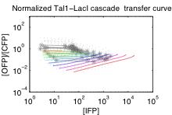
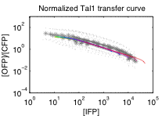


Realization with Characterized DNA parts
Tal1-LacI Cascade
Dox
2A
2A
pHef1a
VP16Gal4
EYFP
EBFP2
pHef1a
rtTA
Tre
Tal1
UAS-T1
mKate
LacI
Hef1a-LacO1Oid
Dox curve
Tal1 curve
LacI curve
Model → Experiment:
Low copy: no effect → no effect
High copy: 30x → 10x
Gradual transition → gradual transition
Max ~10⁰ → 3x higher – 2A effect?
Predict

Slide 60
Onward Through the Tool-Chain…
(yellow (not (cyan (Dox))))
Dox
cyan
not
yellow
Dox
rtTA
CFP
B
EYFP
pHef1a
rtTA
pTre
CFP
pTre
LacI
mirff4
pHef1a-LacO1Oid
EYFP
4xff4

Slide 61
How can the parts of a design work together to adapt it to new uses?
Distributed Power
Demand Response
Morphogenetic
Engineering
device
neighborhood
Spatial
Computing
Synthetic
Biology
IPTG
F
GFP
H
LacI
TetR
aTc
H
F

Slide 62







Morphogenesis enables natural variation
Felinae
Cheetah
Domestic Cat
Felis
Felidae
Pallas Cat
Puma
Pantherinae
Panthera
Tiger
Snow Leopard
Lion

Slide 63






A phylogeny of engineered systems?
SUGV
Warrior
PackBot
LANdroid
miniDroid

Slide 64

Functional Blueprints
Functional behavior that degrades gracefully
Metric for degree and direction of stress
Incremental adjustment program for stress relief
Initial viable system
Idea: incremental motion in viable design space
Abstract functional blueprint networks converge reliably and >100x faster than GAs

Slide 65





Example: “Cartoon” Vascularization
Functional blueprint model of vascularization
Stress: oxygen, elastic stress
Adjustment: leaking, vessel grow/shrink
Red cells are healthy, blue cells are oxygen-deficient
Can model vasculatization and density co-regulation

Slide 66






What if your robot can climb stairs…

Slide 67

… but you want to check cars for IEDs?

Slide 68



Problem: Redesign Complexity
Even “simple” robots require careful design of many interacting components…
… and small changes have large consequences.

Slide 69
iRobot miniDroid Functional Blueprints
Functional blueprints requirements:
Behavior that degrades gracefully
Metric for stress degree & direction
Incremental adjustment program
Initial viable design
Examples:
Step Climbing
(via ascent angle)
Flipper/Body Ratio
Self-Righting
(via torque/mass)

Slide 70


5x Variation Driven by Step Height

Slide 71


Adjusting Component Layout
Functional blueprints control key attributes
The majority of design parameters are implicit!
How are components modified and placed?
e.g., Which way does the flipper extend? Where does the CPU go inside the robot body?
What about changes to number or topology?

Slide 72








Morphogenesis resolves design constraints
Manifold evolution based on biological development
Implicit parameters specified through geometric relationships developed between components
Abstraction of components
Reduced dimensionality
Greater design flexibility
Flipper Length = Axle + Extension

Slide 73
Developmental Programs
Three levels of detail:
Tissue-level rule definition and evaluation
Proto cellular models of program plasticity
Concurrent & blended execution of rules
Manifold operators distort to match the structure of the space on which they execute
Soft-body physics for tissue interaction
Adhesion lets components maintain spatial relations
Plasticity lets components “push” around and through each other

Slide 74




Next Step: Model Integration
battery
servo
encoder
CPU
servo
servo

Slide 75
Summary
The Amorphous Medium abstraction uses manifolds to simplify programming of scalable, robust behavior on space-filling networks
Proto’s four families of space/time operations let geometric aggregate descriptions compile
into approximating local actions
Distributed Power
Demand Response
Morphogenetic
Engineering
device
neighborhood
Spatial
Computing
Synthetic
Biology
IPTG
Spatial abstractions can help us solve complex problems, from networks to biology and beyond…
F
GFP
H
LacI
TetR
aTc
H
F

Slide 76
Proto is available
http://proto.bbn.com/
(or google “MIT Proto”)
Includes libraries, compiler, kernel, simulator, platforms
Licensed under GPL with linking exception

Slide 77


Acknowledgements:
Aaron Adler (co-PI)
Brett Benyo
Jeff Berliner
Jeff Cleveland
Jessica Lowell
Gretchen Markiewicz
Hala Mostafa
Rick Schantz
Kyle Usbeck
Fusun Yaman
Susan Katz, Joseph Loyall (PMs)
Interns:
Katie McGuire, Taylor Campbell
Douglas Densmore (co-PI)
Swapnil Bhatia
Traci Haddock
Viktor Vasilev
Chenkai Liu
Ron Weiss (co-PI)
Jonathan Babb
Noah Davidsohn
Tim Shepard
Nelson Elhage
Annan Mozeika
Ben Axelrod
Vinayak Ranade
Sponsors:

Slide 78
Backup Slides: Spatial Computing

Slide 79
More formally...
A spatial computer is a collection of computational devices distributed through a physical space in which:
the difficulty of moving information between any two devices is strongly dependent on the distance between them, and
the “functional goals” of the system are generally defined in terms of the system's spatial structure
Notice the ambiguities in the definition

Slide 80
Graphs
Amorphous/
Continuous
Crystalline
(e.g. CAs)
(w. Dan Yamins)

Slide 81
Graphs
space complexity
density
jitter
grain size
Amorphous/
Continuous
Crystalline
(e.g. CAs)
(w. Dan Yamins)

Slide 82
Graphs
spatial computing
space complexity
density
jitter
grain size
Amorphous/
Continuous
Crystalline
(e.g. CAs)
(w. Dan Yamins)

Slide 83
Backup Slides: Demand Response

Slide 84

Initial ColorPower Prototype Devices
Atmel AVR Raven
8-bit processor
802.15.4 wireless
Current sensor
Power control w. relay
Button, rotary knob
BOM: < $100

Slide 85
Backup Slides: Synthetic Biology

Slide 86
Backup Slides: Morphogenetic Engineering

Slide 87
FB Network Convergence Dynamics
0.0020
0.0015
0.0010
0.0005
Experiment 1: Induce a 100% perturbation in one of the attributes
For all random graphs, total stress decreases exponentially
Majority of the stress is the user perturbation (LEFT)
The rest of the system disperses the stress efficiently (RIGHT)

Slide 88

Resilience to Parameter Change
Experiment 2: Vary perturbation from 100% to 500%
Regardless of the size of the constraint graph, linear relationship between the perturbation size and convergence time (LEFT)
Experiment 3: Vary update rate (drive rate) from 0.01% to 50%
When increment rate is too high the system becomes non-viable (RIGHT)

Slide 89



MADV Architecture
Models
Updated Design
Current Design
Morphogenetic Simulator
Evaluators
Functional Blueprints (FB)
Blend Updates
Robot Model Evaluator
Cost Evaluator
FB Executor
Environmental Evaluator (obstacle courses)
Blend Stresses
Stress Converter
Evaluation Metrics

Slide 90

5x Variation Driven by Step Height

Slide 91
Program Representation: Manifold Rules
Precondition: Tissue = limb-bud
Proximodistal exists
Effects: Scale(Proximodistal,1.5)
→ Latch(limb)
Precondition: Tissue = egg
Anteroposterior > 0.5
Mediolateral > 0.33
Effects: Latch(limb-bud)
Precondition: Tissue = limb
Proximodistal > 0.8
Effects: Latch(wheel)
Precondition: Tissue = egg
Anteroposterior < 0.5
Mediolateral > 0.33
Effects: Latch(limb-bud)
Precondition: Tissue = limb
Proximodistal < 0.8
Anteroposterior < 0.5
Effects: Latch(drive)
Precondition: Tissue = limb-bud
Effects: Coordinatize(Proximodistal)
Precondition: Tissue = limb
Proximodistal < 0.8
Anteroposterior > 0.5
Effects: Latch(mount)
Parallel application, continuous manifold evolution, conflict resolution by actuator blending
Benefits: implicit relations, easy to modify/insert

Slide 92

Tissue-Level Developmental Model

Slide 93

Distortable Development in Proto

Slide 94
Soft Body Tissue Development

Slide 95
Jake’s internal notes to self

Slide 96
Slide Count Distribution
Infrastructure: 10 (title, 2 splash, 4 TOC, 3 finale)
Spatial Computing: 7
Proto/Amorphous Medium: 8
Demand Response: 10
Synthetic Biology: 17 (16 + 13 compile example)
Morphogenetic Engineering: 11 (9+2x2 build)
Total: 53 + infrastructure

